Slide 1
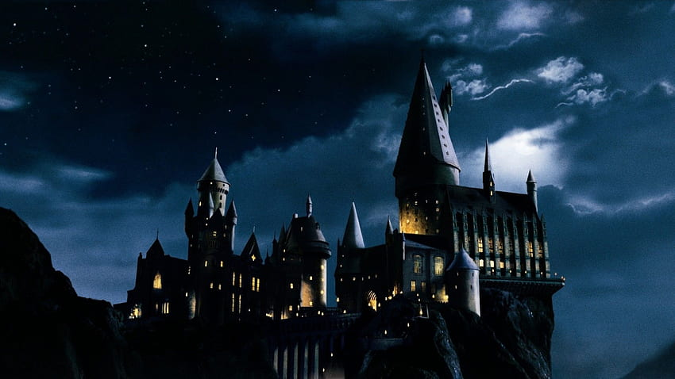
PRESENTATION BY:
D. MURALI
22091A0258
DESIGN THINKING & INNOVATION HARRY POTTER

Slide 2
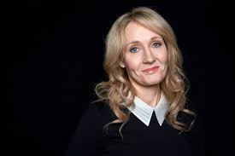
Introduction to Harry Potter :
Harry Potter is a series of seven fantasy novels written by British author J. K. Rowling.
Starting with “Harry potter and the philosopher’s stone “ published in 1997.

Slide 3
Theme of Harry potter:
The author J.K Rowling has shown that the conflict between good and evil is one of the main themes throughout all the stories.
The antagonist Voldemort embodies evil is the main enemy for the protagonist harry to fight against.

Slide 4
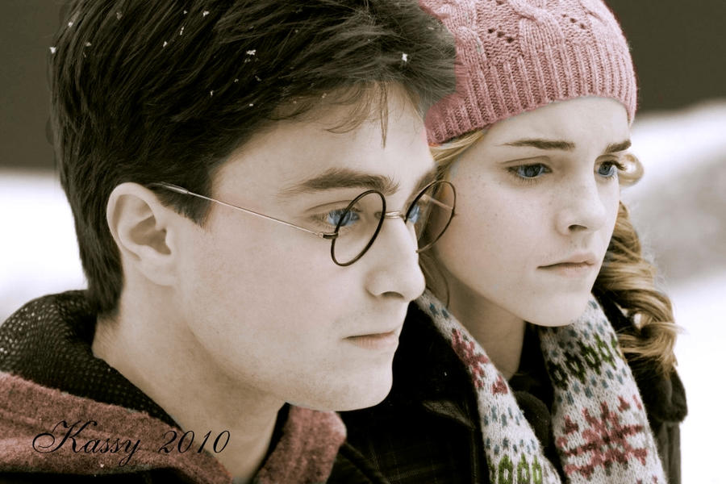
Characters in the world of Harry potter:
Harry potter: the protagonist ,an orphaned wizard with a lightning shaped scar on his forehead.
Hermione Granger: Harry’s intelligent and resourceful best friend.

Slide 5
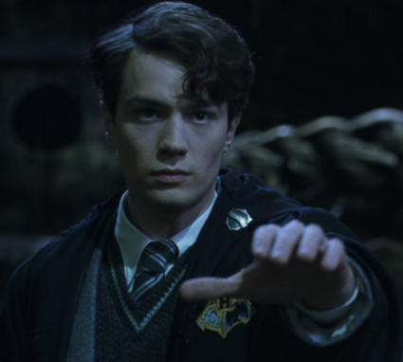
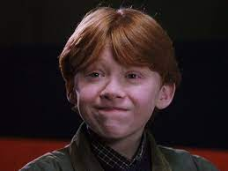
Characters in the world of Harry potter:
Ron Weasley: Harry’s humorous and loyal best friend.
Lord Voldemort: He was the antagonist who according to a prophecy has "the power to vanquish the Dark Lord"

Slide 6
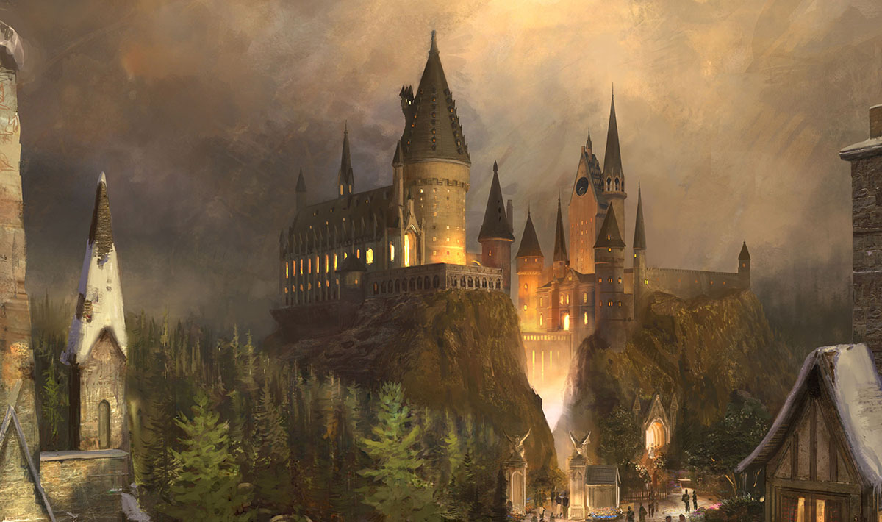
The Hogwarts school of witchcraft and wizardry:
Founded around the 9th century and 10th century by Gryffindor, Rowena Ravenclaw, Helga Hufflepuff and Salazar Slytherin, Hogwarts was established in the Highlands of Scotland to educate young wizards and witches as well as to keep students safe from Muggle persecution.

Slide 7
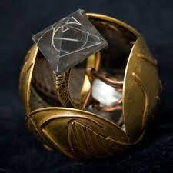
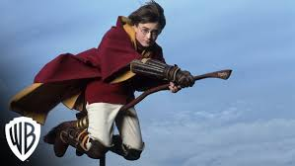
Magical objects and Artifacts:
The series features various magical objects like sorting hat, invisibility cloak, and the Marauder’s Map.
The philosopher’s stone, the goblet of fire, and the Deathly Hallows are the Key artifacts in the story.
These a objects have significant powers and play important roles in the plot.

Slide 8
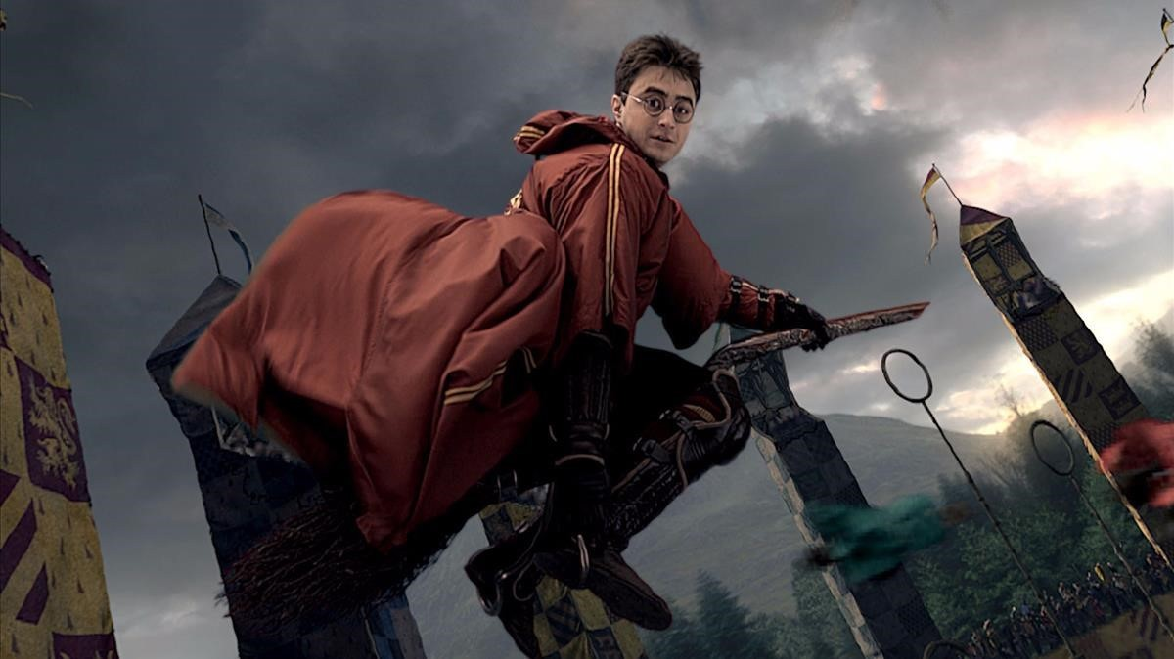
Quidditch –the wizarding sport:
It first appeared in the novel Harry Potter and the Philosopher's Stone (1997).
It is a dangerous but popular sport played by witches and wizards riding flying broomsticks.
The game includes elements of strategy, skill, and teamwork.

Slide 9
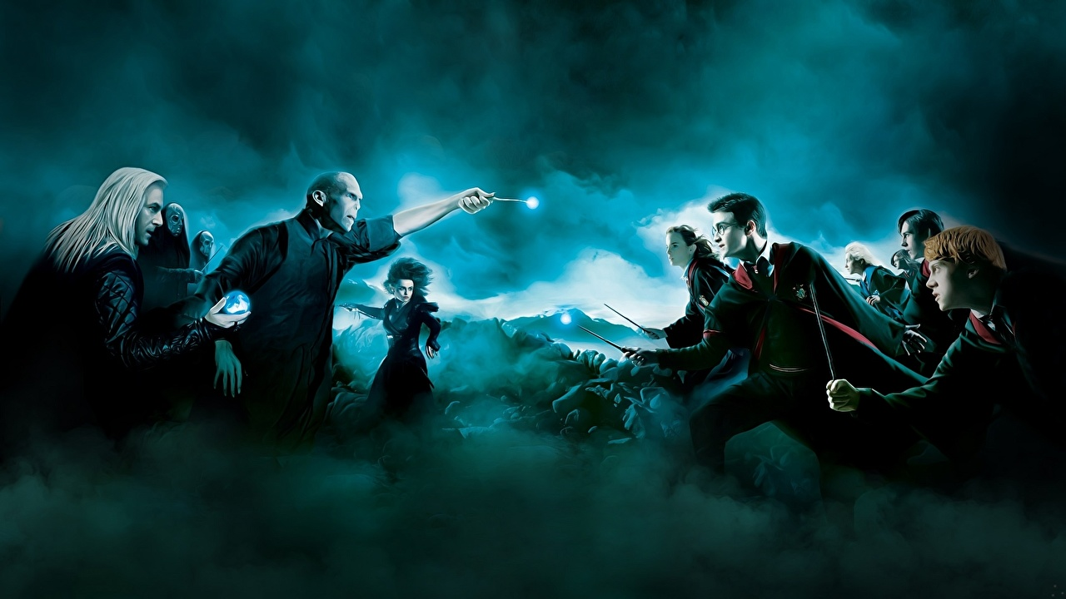
The battle between good and evil:
Harry and Voldemort duel each other around the castle while everyone else fights in the Great Hall. Harry grabs Voldemort and calls him "Tom," throwing themselves off the castle and morphing in the air, before hitting the ground outside the castle and starting the final duel.

Slide 10
Adaptations and popularity:
The books have sold more than 600 million copies worldwide and have also given rise to the popular film adaptations produced by Warner Bros. Pictures, all of which have been highly successful in their own right. And grossed billons of dollars all over the world.

Slide 11
The Magical World of Harry Potter :
The Harry Potter series is set in a magical world parallel to our own.
It features various magical creatures such as dragons, owls, and unicorns.
Spells, potions, and magical objects play a significant role in the story.

Slide 12
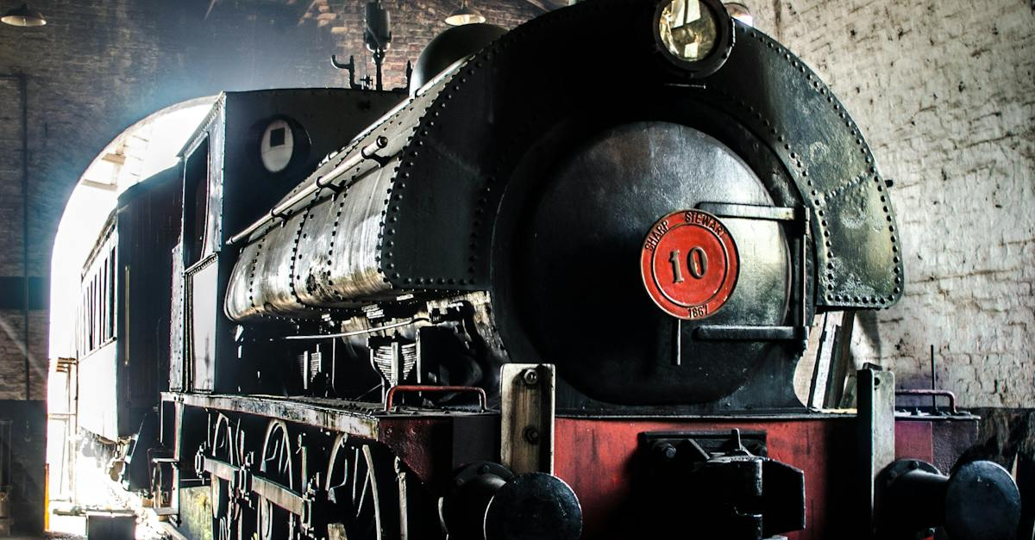
Hogwarts Express:
The Jacobite Steam Train / Hogwarts Express
It is also known as the 'Jacobean Train' and the 'Harry Potter Steam Train'.

Slide 13
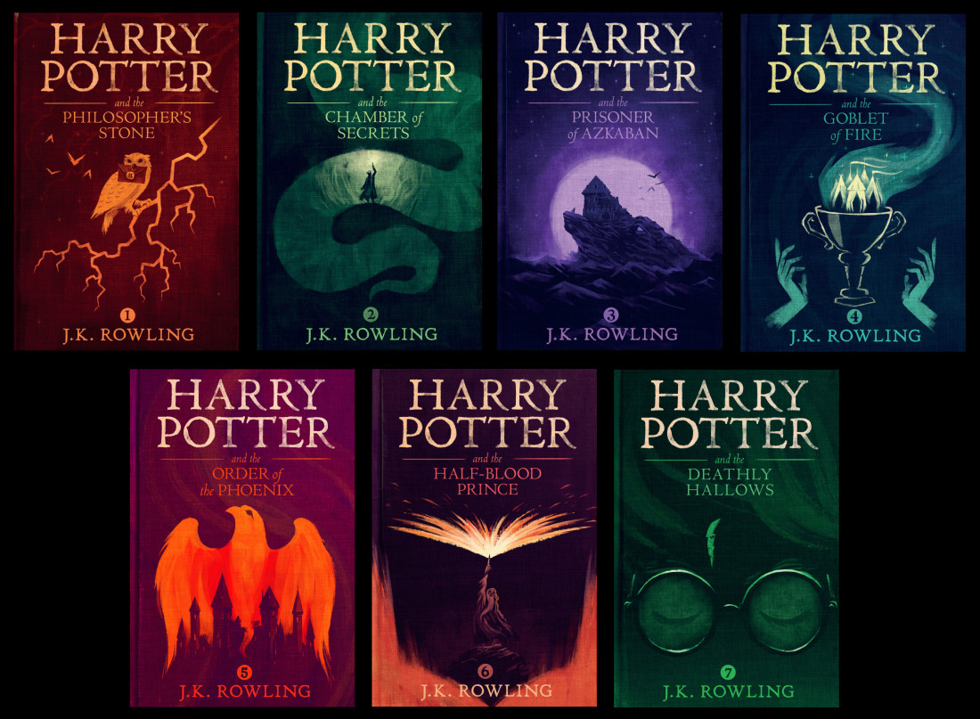
Legacy and impact:
Something like Harry Potter had a hand in helping millions of readers and moviegoers realize what they like. It's not so easy to just dismiss something like that entirely. The author, on the other hand, can be ignored. Once their work is out in the world, it no longer belongs to them in many ways.

Slide 14
Conclusion:
Harry surrenders to Voldemort and dies. The defenders of Hogwarts continue to fight on; Harry is resurrected, faces Voldemort and kills him. An epilogue titled "Nineteen Years Later" describes the lives of the surviving characters and the impact of Voldemort's death.

Slide 15
THANK YOU…..!

